Slide 1



Starting Now
ML for Trading³ in the Age of AI
From Idea to Live Trading: Your Process is your Edge
Stefan Jansen
CEO

Slide 2

ML4T in the Age of AI
What’s new in the 3rd Edition

Slide 3
About Stefan Jansen
Stefan is the founder and Lead Data Scientist at Applied AI. He advises Fortune 500 companies, investment firms and startups across industries on data & AI strategy, building data science teams, and developing machine learning solutions.
Stefan holds Master degrees in Computer Science from Georgia Tech and in Economics from Harvard and Free University Berlin and is a CFA Charterholder. He has also been teaching data science at Datacamp and General Assembly.
Stefan Jansen
CEO

Slide 4
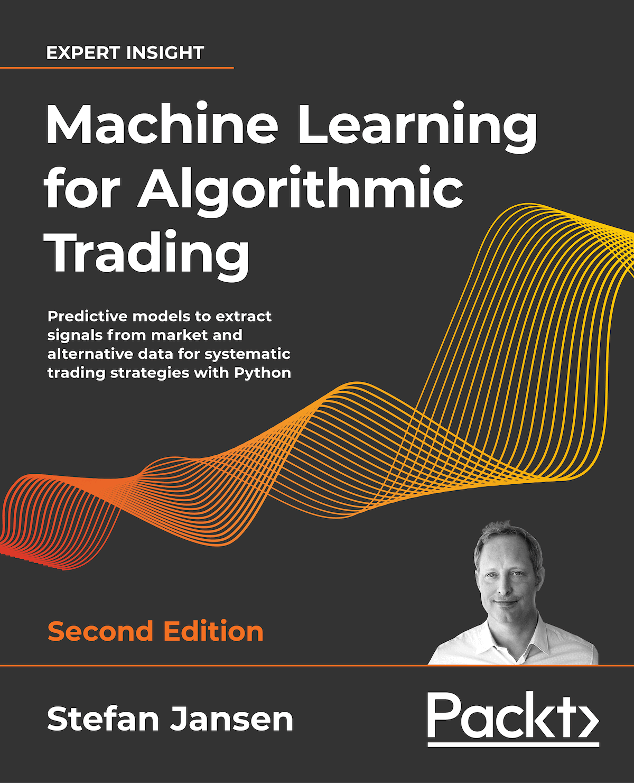
ML for Trading: end-to-end strategy workflow
On over 800 pages and 150 notebooks, dozens of examples of how ML can add value to trading.
Four parts and 24 chapters cover:
key aspects of data sourcing, financial feature engineering, and portfolio management,
the design and evaluation of long-short strategies based on a broad range of ML algorithms,
how to extract tradeable signals from financial text data like SEC filings, earnings call transcripts or financial news,
using deep learning models like CNN and RNN with financial and alternative data, how to generate synthetic data with GANs, and training a trading agent using deep reinforcement learning.
>
Pg: 1

Slide 5
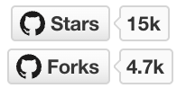
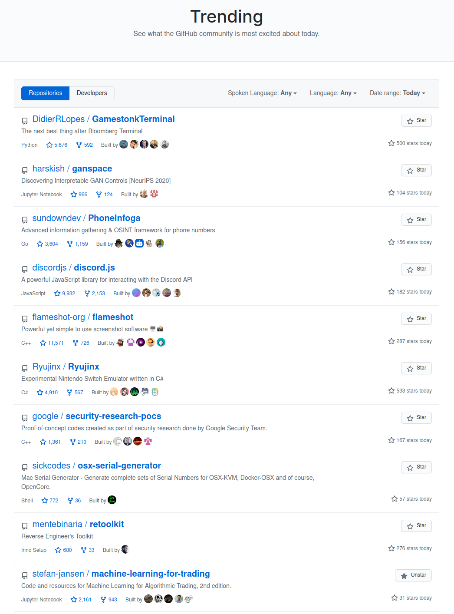

Plenty of (free) resources to experiment
Code examples as starting point for further development
Repository at: github.com/stefan-jansen/machine-learning-for-trading
Budding community at: exchange.ml4trading.io
Among Top 10 most popular GitHub repos!
>
Pg: 1

Slide 6
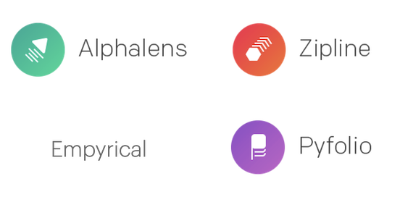
ML for Trading in Python
Complementary open-source libraries support strategy development
www.ml4trading.io
>
Pg: 1

Slide 7
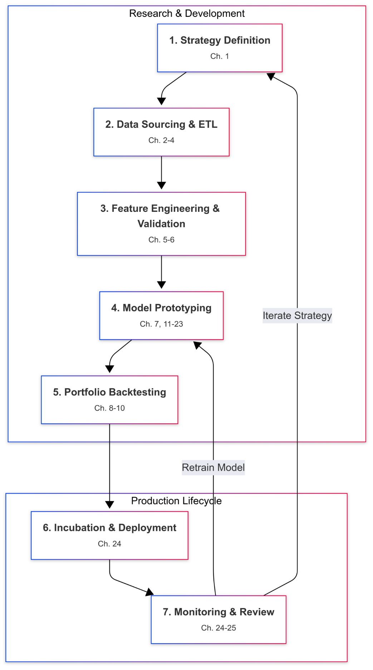
Motivation: Why a Third Edition?
The world has changed dramatically since the second edition. The post-2020 market has been defined by unprecedented shocks and regime shifts.
The AI landscape has been revolutionized by Transformers, Large Language Models (LLMs), and Generative AI, creating entirely new possibilities.
The industry's focus has matured from "can we predict it?" to "can we trust the prediction?" This demands a new emphasis on causal inference and robustness.
Competitive edge is no longer in a single secret model, but in an industrial-grade process—an "alpha factory"—that can adapt and scale.
>
Pg: 1

Slide 8
The Evolution of the Book
1st Edition: A foundational introduction to applying ML in the trading domain.
2nd Edition: Deepened the content, introducing an end-to-end workflow, broader data sources (intraday, international), and early deep learning models (CNNs, GANs).
Reader Feedback & Industry Demand: The #1 request was for more guidance on production systems, handling real-world data complexities, and navigating the latest AI breakthroughs.
3rd Edition: A complete rewrite and expansion. It’s not just an update; it’s a new book built around a modern, process-driven philosophy for the new era of quant finance.
>
Pg: 1

Slide 9
What’s New in the 3rd Edition? An Overview
Feature | 2nd Edition | 3rd Edition
Core Philosophy | ML4T Workflow | The 7-Stage Alpha Factory (Process is your edge)
Data Engine | pandas | Polars (High-performance, modern API)
Data Focus | Daily, some intraday | Raw Tick Data & Market Microstructure
Asset Coverage | Mostly US Equities | Cross-Asset: Equities, Futures, FX, Options, Crypto
AI/ML Models | Early Deep Learning, GANs | Transformers, LLMs, RAG, Autonomous Agents
Validation | Standard backtesting | Advanced Validation & Causal Inference (DML, Conformal Prediction)
Production Focus | Conceptual | Deep Dive on MLOps & Live Trading Systems
>
Pg: 1

Slide 10
Polars for High-Performance Data Engineering
Why the Switch? pandas is powerful but struggles with the scale and performance needs of modern quant research.
The Polars Advantage:
🚀 Speed: Built in Rust, Polars leverages all CPU cores for parallel processing, making it orders of magnitude faster.
🧠 Memory Efficiency: Smarter query optimization and memory management => work with much larger datasets on the same machine.
✨ Modern API: A more consistent and expressive API prevents common errors and encourages cleaner code.
What Readers Gain: process raw, tick-level datasets and run complex feature engineering pipelines efficiently, the foundation of modern alpha research.
>
Pg: 1

Slide 11
Beyond US Equities: A Multi-Asset World
Markets are interconnected. A modern quant needs to operate across asset classes to find diversified sources of alpha.
This edition provides a practical guide to the data challenges unique to different domains:
Equities: Market fragmentation, corporate actions.
Futures: Building continuous contracts, term structures.
FX & Crypto: Decentralized markets, 24/7 data streams.
Options: Modeling high-dimensional volatility surfaces.
The book provides dedicated code and strategies for handling this complexity, moving from a stock-centric view to a global macro perspective.
>
Pg: 1

Slide 12
Intraday & Tick Data: The Microstructure Edge
The 2nd edition touched on intraday data; the 3rd edition dives into the raw, atomic level of markets.
We show you how to:
Parse raw binary exchange messages (e.g., NASDAQ ITCH) to see every order, cancellation, and trade.
Reconstruct the Limit Order Book (LOB) to understand market liquidity and depth.
Move beyond time-based bars to information-driven bars (volume, dollar, imbalance bars) to reduce noise and improve model performance.
This is where the real alpha hides in short-term strategies.
>
Pg: 1

Slide 13
Deep Learning for Time Series: The Great Debate
The field has moved far beyond basic LSTMs. We cover the modern landscape.
Path A: Decomposition: Models like N-BEATS that break a time series down into interpretable components like trend and seasonality.
Path B: Attention: The Transformer architecture, which captures complex, long-range dependencies.
We address the "Great Debate": Do complex Transformers really outperform simple linear models for forecasting?
You'll learn about next-gen architectures (PatchTST, iTransformer) and gain a framework for choosing the right tool for the job, moving beyond the hype.
>
Pg: 1

Slide 14
Transformers in Finance: Beyond the Hype
Transformers have solved natural language representation. We show you how to apply this power to finance.
From Text to Features: The book details the modern workflow of taking pre-trained language models (like BERT) and fine-tuning them on financial text (e.g., SEC filings, earnings calls).
Practical Use Cases:
Building sophisticated sentiment models.
Performing Named Entity Recognition to extract structured data from news.
Explaining model decisions using SHAP to ensure transparency and manage risk.
>
Pg: 1

Slide 15
LLMs & Generative AI: The Reasoning Engine
This is the paradigm shift from using AI for prediction to using it for reasoning.
The Core Problem: LLMs can "hallucinate," which is unacceptable in a high-stakes financial context.
The Solution: Retrieval-Augmented Generation (RAG). We provide a blueprint for building RAG systems that ground the LLM in a trusted, verifiable knowledge base.
Flagship Example: Building a 10-K Due Diligence Assistant that can answer complex questions about an annual report and provide citations, transforming it into a reliable analyst co-pilot.
>
Pg: 1

Slide 16
Autonomous Trading Agents: The Action Wave
The next frontier is building agents that can reason, plan, and execute complex tasks independently.
We provide the blueprint for building production-ready financial agents:
Cognitive Architectures: Implementing reasoning patterns like ReAct (Reason+Act).
Tool Integration: Securely giving agents access to financial APIs and data sources.
Agentic Frameworks: Using leading tools like LangChain, CrewAI, and LlamaIndex.
Capstone Project: Build an Equity Analyst Agent that autonomously gathers news, fetches market data, and queries SEC filings to generate a comprehensive stock report.
>
Pg: 1

Slide 17
Production-Grade Code & MLOps
A backtest is not a business. This edition is obsessed with bridging the gap from research to live, reliable trading.
Modern DevOps Practices: Every project is structured for reproducibility using Docker, cloud deployment patterns, and CI/CD principles.
MLOps for Trading:
Feature Stores and Model Registries (MLflow) to prevent training-serving skew.
Automated Monitoring for concept drift and alpha decay using tools like the Population Stability Index (PSI).
A/B testing new models safely in a live environment.
This is the material you need to get hired and be effective on a professional quant desk.
>
Pg: 1

Slide 18
Practical Workflows & Causal Inference
This edition is built on a framework of intellectual honesty and rigor.
The Strategy Term Sheet: Before writing code, you define your hypothesis, data, and failure conditions. A crucial defense against bias.
Advanced Validation: We go beyond standard backtesting with purged and embargoed cross-validation and calculating the Deflated Sharpe Ratio to account for backtest overfitting.
Causality is King: We introduce powerful techniques like Double Machine Learning (DML) to distinguish true causal drivers from spurious correlations, building strategies that are far more robust.
>
Pg: 1

Slide 19
Final Thoughts & Who This Book Is For
This book is for:
Data Scientists & ML Engineers moving into finance.
Quantitative Analysts looking to upgrade their toolkit to the state-of-the-art.
Investment Professionals aiming to leverage modern AI for better decisions.
Ambitious Students preparing for a career in quant finance.
The Impact: This edition doesn't just teach you models; it teaches you a process. It equips you with the framework, tools, and mindset to build a durable edge in a competitive and constantly evolving industry.
Future Directions: The book is a living project, with an online companion, community contributions, and continuous updates.
>
Pg: 1

Slide 20
Thank You

